Slide 1
Electronic Devices
Final Term Lecture - 08
Reference book:
Electronic Devices and Circuit Theory (Chapter-7)
Robert L. Boylestad and L. Nashelsky , (11th Edition)

Slide 2
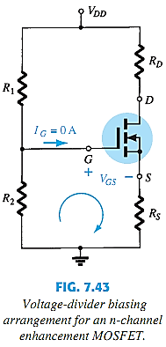


E-MOSFET VOLTAGE-DIVIDER BIAS
E-MOSFETs use the same procedure to JFETs and D-MOSFETs.

Slide 3
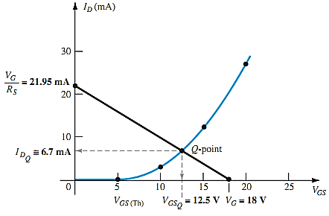
E-MOSFET VOLTAGE-DIVIDER BIAS
Graphical Approach:
Calculate the value for
Plot V_{GS} vs I_{D} using
Plot for:
V_{GS} = V_{G} at I_{D} = 0A
V_{GS} = 0V at I_{D} = V_{G}/R_{S}
Identify the Q-point.

Slide 4
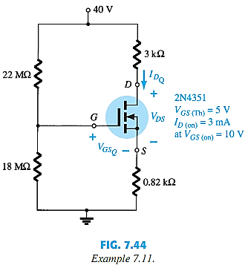


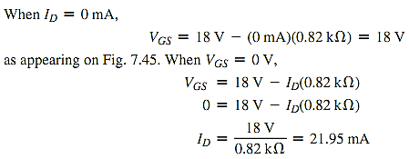
E-MOSFET VOLTAGE-DIVIDER BIAS EXAMPLE
Determine I_{D}, V_{GS}, and V_{DS} for the following network:

Slide 5
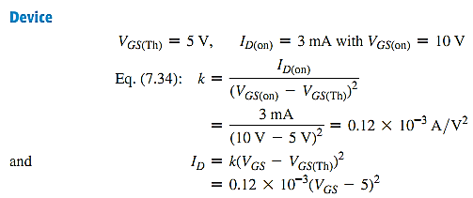
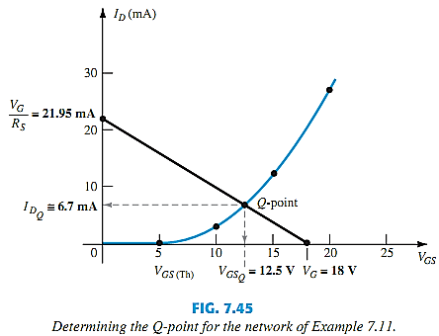
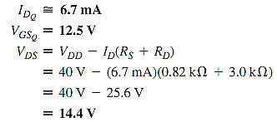
E-MOSFET VOLTAGE-DIVIDER BIAS EXAMPLE

Slide 6
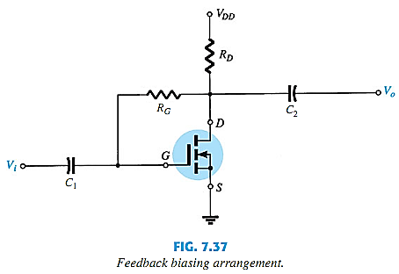
E-MOSFET FEEDBACK BIAS

Slide 7
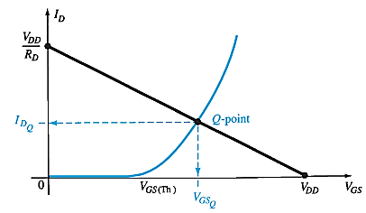
E-MOSFET FEEDBACK BIAS
Graphical Approach (to find V_{GSQ} and I_{DQ}):
Calculate the value for
Plot V_{GS} vs I_{D} for the range of interest.
Plot :
Identify the Q-point.

Slide 8
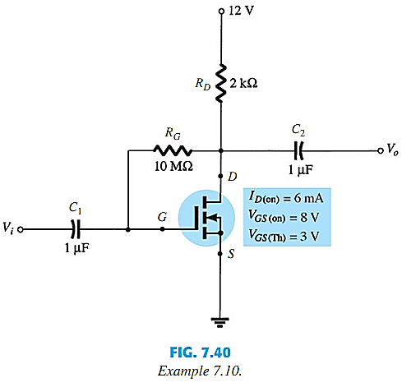
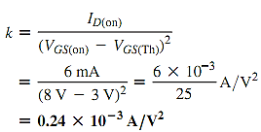
E-MOSFET FEEDBACK BIAS EXAMPLE
Example 7.10: Determine I_{DQ} and V_{DSQ} for the following circuit:

Slide 9

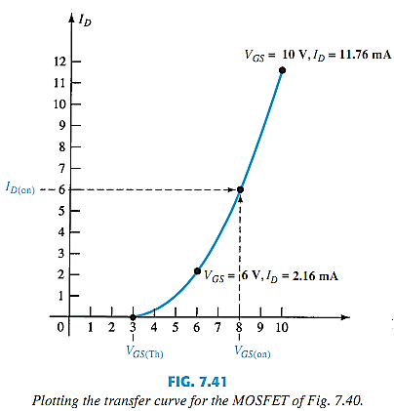

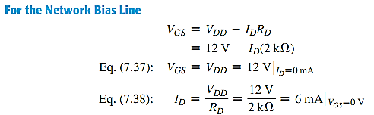
E-MOSFET FEEDBACK BIAS EXAMPLE CONTD.

Slide 10
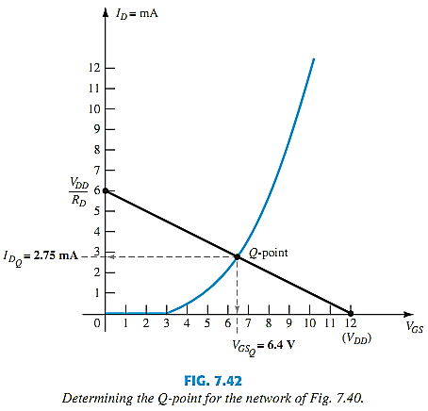

E-MOSFET FEEDBACK BIAS EXAMPLE CONTD.

Slide 11
p-CHANNEL FETs
For p-channel FETs the same calculations and graphs are used, except that the voltage polarities and current directions are the opposite.
The graphs will be mirrors of the n-channel graphs.

Slide 12
End of Lecture-8

